Slide 1
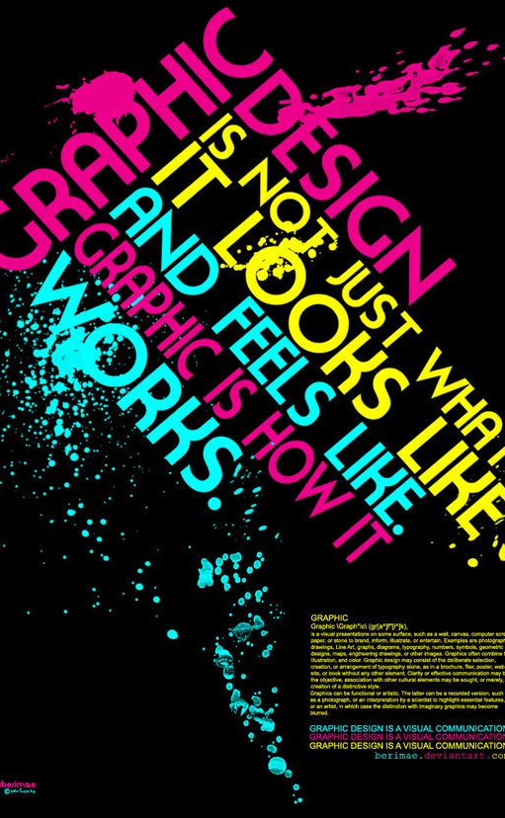
ROP
Computer Graphic Arts
Mrs. Jennifer Bible
Designed to meet California State Art, Technology, and Common Core Standards.

Slide 2
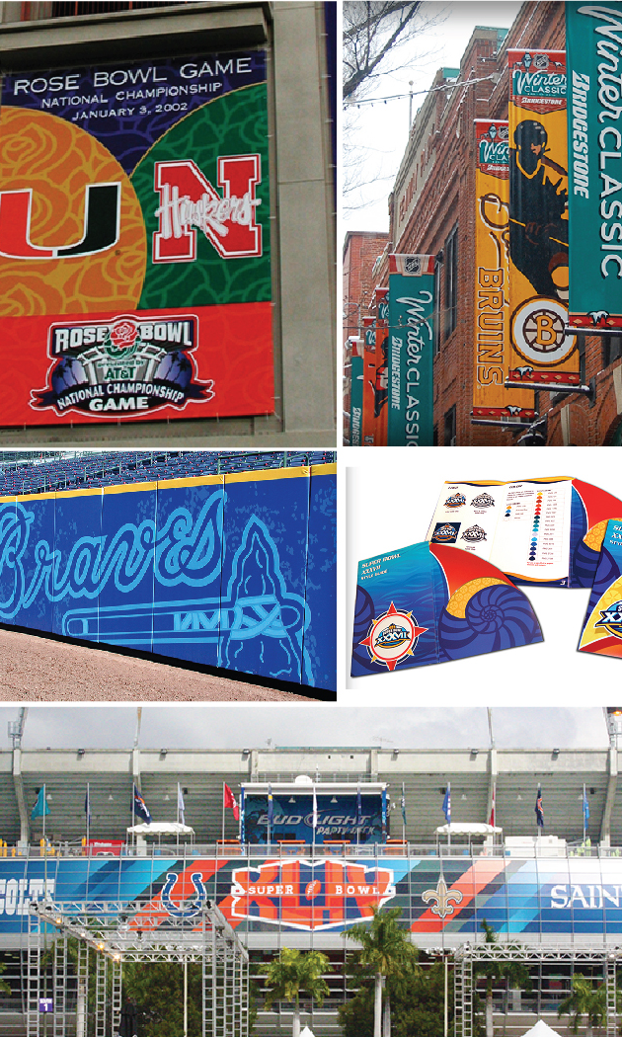
About Me
Teaching for 5 years
(3 @ Cal High).
15+ years experience in Graphic Design &
Art Direction.
Freelance / Contract Graphic Designer.

Slide 3

Goals
Help students develop a working knowledge of Adobe Creative Suite
Understand the value of color theory, typography, and layout.
Design various materials
for print (mostly) & web
Develop the skill of Creative Problem Solving and promote Creative Thinking

Slide 4
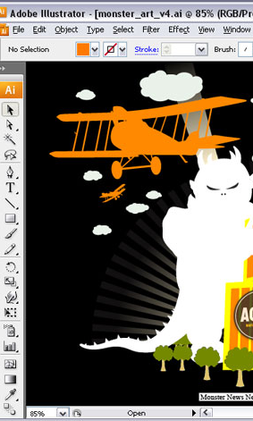
Adobe Illustrator
Used to create vector artwork, especially good for print graphics. Will use to develop logos, posters, and typographic works.

Slide 5
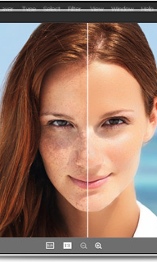
Adobe Photoshop
Used to create raster artwork, especially good for web and print graphics. Will use to enhance photos and create layered photographic designs.

Slide 6
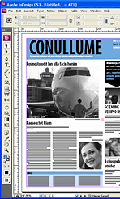
Adobe InDesign
Used to create publications for print and web such as flyers, catalogs, and magazines.
We will use to create multi-page marketing materials.

Slide 7
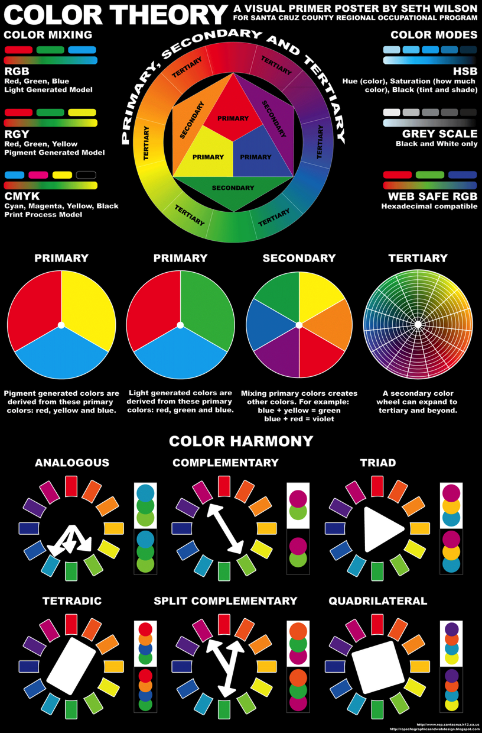
Color Theory
Color is one of the strongest visual elements in printed and web graphics. We will study and learn about the various aspects of color.

Slide 8
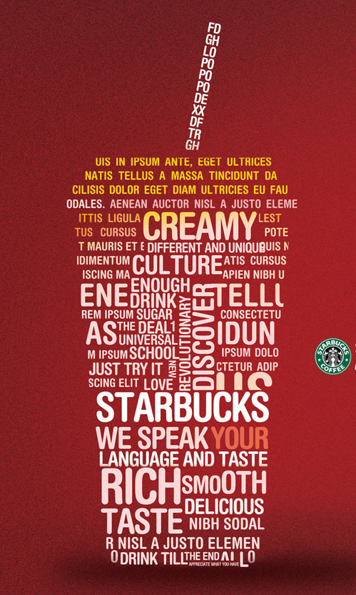
Typography
The type face (font) you use is critical to your design. We will study type, type families, and typographers.

Slide 9
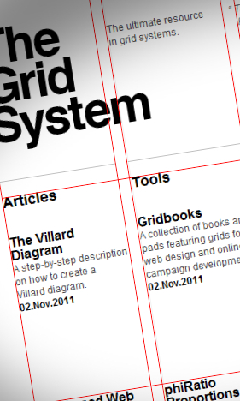
Layout
We will discuss hierarchy in layout, image and text placement and work on proportion of all elements to create cohesive designs.

Slide 10
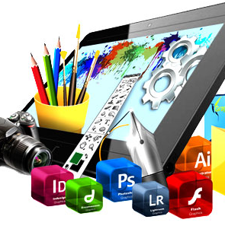
And more…
Printing & publishing
Careers in computer
graphic arts
Presentation & critique skills

