Slide 1
Type, Kerning, & Leading
Fixing your text to be visually pleasing
pleasing

Slide 2
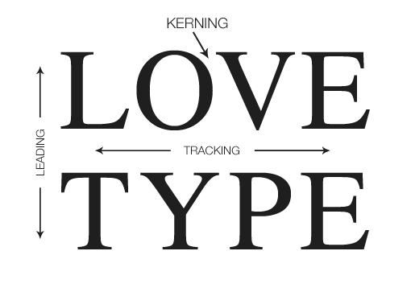

Slide 3
Typography
The art and technique of arranging type to make written language legible, readable, and appealing when displayed.

Slide 4
Typeface
(also known as a font family) is a set of one or more fonts each composed of glyphs that share common design features such as Garamond, Helvetica or Times New Roman.

Slide 5
Font
Traditionally, a font describes a subset of a Typeface – each font embodies a particular size and weight such as Garamond 12 point versus Garamond Italic 8 point. Today it is used interchangeably with Typeface for Print, but exists in CSS for web.

Slide 6
Kerning
The process of adjusting the spacing between characters in a font to create visually even spacing.

Slide 7
Tracking
Refers to uniformly increasing or decreasing the horizontal spacing between a range of characters.

Slide 8
Leading
Refers to the spacing between the baselines of successive lines of type.

Slide 9
Examples of Poor Kerning Choices

Slide 10
Examples of Poor Typeface & Kerning Choices

Slide 11
Poor Handwritten Kerning Choices

Slide 12
Bad Kerning is EVERYWHERE

Slide 13
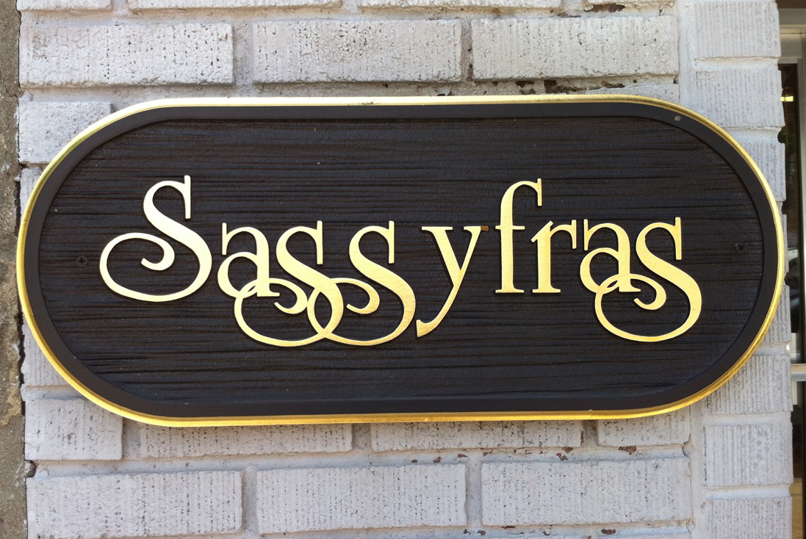

Slide 14
To make sure this does NOT happen to you – start with the Character Panel

Slide 15
The Character Panel…
is where you will control your typography. You can make all your type choices here. Start with your Typeface, weight and size.

Slide 16
The Character Panel…
is where you will control your kerning.

Slide 17
The Character Panel…
is where you will control your leading.

Slide 18
The Character Panel…
is where you will control your tracking.

Slide 19
Assignment
To continually use great font choices, kerning, tracking, and leading.
Extra Credit: Take up to 3 photos of poor kerning and email me your images.

