Slide 1
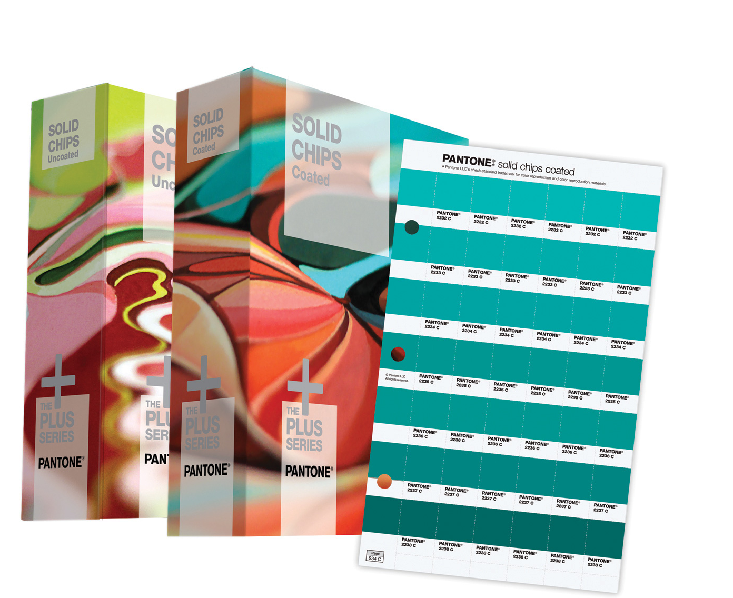
Pantone Matching System
Pantone, CMYK & RGB
Explained
Watch the Video First
https://www.youtube.com/watch?v=9hirYMZ7PQc

Slide 2
What is Pantone Color or PMS? PMS stands for the Pantone Matching System, a proprietary numbering system for colors used in graphic arts.

Slide 3
Pantone Matching System Solid Colors
The heart of the PMS system is solid color ink printed on paper. Why? Solid colors represent the truest representation of color intent in graphic arts. Solid color printing, also known as spot or offset, is the process by which a single color is formulated and then applied through the printing process.
Solid Ink Colors are mixed to the desired color before the ink is applied to the paper, much as paint colors are mixed before you paint a wall. Solid PMS colors are the ink types usually used in short-run “quick-printing” as well as promotional printing, and especially when precise color patching is required (such as for logos).

Slide 4
Solid Color Ink Printing
This type of printing uses a series of plates, one plate for each color of ink.
The ink is pre-mixed to the desired color before the printing process
Screen Printing
Offset Printing

Slide 5
Solid Colors
Pantone has 2,678 solid colors (and counting), broken out in the following way:

Slide 6
But sometimes you must print in process (CMYK)… We all know that solid color printing, also known as offset or spot color printing, is the most accurate, but also the most expensive. Therefore Pantone has two guides for process printing that help you achieve the closest match to PMS when budgets are tight.

Slide 7
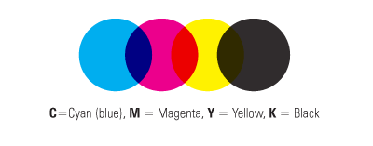
Process Colors / CMYK
Typically used in commercial printing to produce full color printing. Even though there are only four colors of ink used, they are overlapped on the printing press to create the illusion of the nearly unlimited numbers of colors you see in a photograph.

Slide 8
Process / CMYK Printing
This type of printing uses a series of 4 plates, one plate for each CMYK color of ink.
The color is divided up into percentages of CMYK for example
PMS 286 Blue:
100c 84m 11y 3k
Digital Printing
Laser Printing

Slide 9
And sometimes you’re not printing at all… The digital world uses RGB color or Hex (hexadecimal) color. RGB and Hex color values are supported in all browsers. RGB colors are specified with: rgb(red, green, blue). Each parameter (red, green, and blue) defines the intensity of the color as an integer between 0 and 255. For example, rgb(0, 0, 255) is rendered as blue, because the blue parameter is set to its highest value (255) and the others are set to 0. Hexadecimal color uses integers between 00 and FF specifying the intensity of the color This would be PMS 286 blue (00 39 A6).

Slide 10
See How Designers Use PMS
Check out Videos Here: https://www.pantone.com/color-systems-graphics

