Slide 1
Is this design?
Stand up if your response is yes
Stay Seated if your response is no

Slide 2
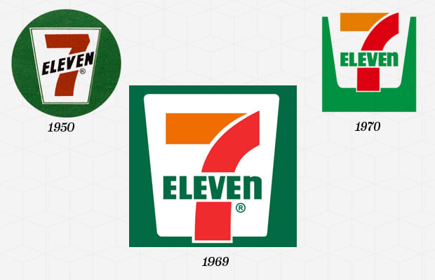

Slide 3
7-Eleven Year Company Founded: 1927 Year Logo Introduced: 1946 Logo Designer: Fran Gianninoto & Associates (1969) The company was started pre-depression by John Jefferson Green when he started selling bread, milk, and eggs out of the ice houses of the Southland Ice Company. He eventually bought the Southland Ice Company and continued operations, despite going bankrupt during the depression. In 1946, as part of the post-war effort, the stores' names were changed to 7-Eleven, and the logo became the company name written a cup inside of a green circle. This design was used until 1970, when it was modernized to become the logo we see today.
YES

Slide 4
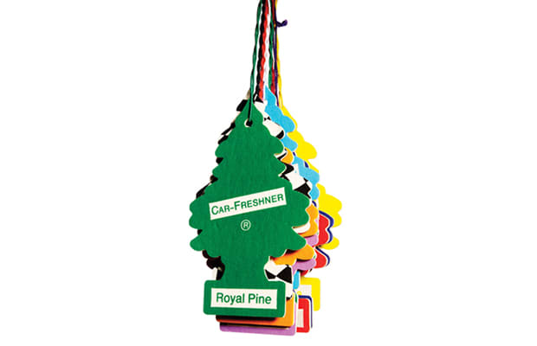

Slide 5
Little Trees Year Invented: 1952 Designer: Julius Samann Air fresheners can be found in almost any car these days. The tiny tree shape has become synonymous with "fresh air" (and used cars). Little trees, invented in 1952 by julius samann, are the original tree-shaped air freshener. This iconic design has found its way into pop culture and movies like the fisher kind, seven, and repo man.
YES

Slide 6
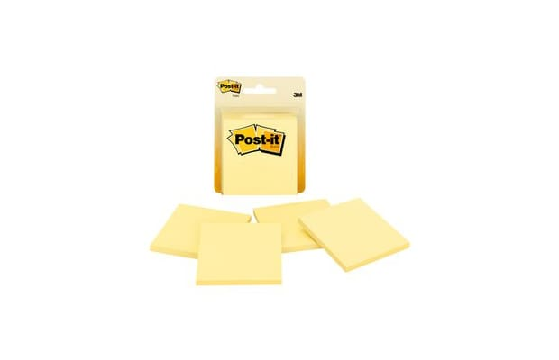

Slide 7
Post-it Note Year Invented: 1968 Designer: Art Fry/Spencer Silver While attempting to develop a super-strong adhesive, dr. Spenser silver accidently created something that was pretty much the complete opposite—an adhesive that could be applied, removed, and applied again, without damage to the object it was applied to. He attempted to market the "low tack" adhesive to 3M to no avail. In 1974, art fry overheard silver talking about his invention and quickly realized a use for the tack; he applied it to paper and created the post-it note.
YES

Slide 8
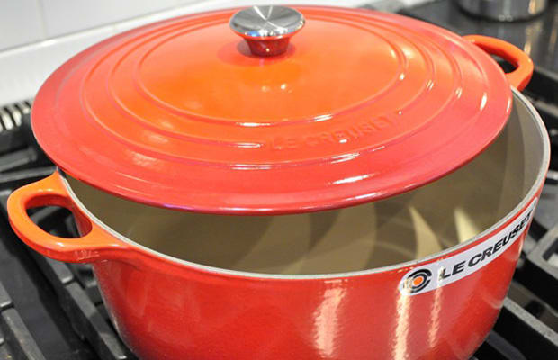

Slide 9
Le Creuset French Oven Year Invented: 1925 Designer: Armand Desaegher And Octave Aubecq Le creuset was founded in the french town of fresnay-le-grand, aisne, picardy by armand desaegher and octave aubecq. Desaegher (A caster) and aubecq (an enamel specialist), created the french oven as their first product, which is still their most famous item and one your mother (or you) probably own to make casseroles.
YES

Slide 11
FedEx Year Company Founded: 1973 Year Logo Introduced: 1973 Logo Designer: Lindon Leader, Landor Associates (1994) In 1994, the current logo was created. If you look closely at the space between the E and the X, you will notice a small arrow hidden in between, meant to symbolize FedEx's speed and accuracy.
YES

Slide 12
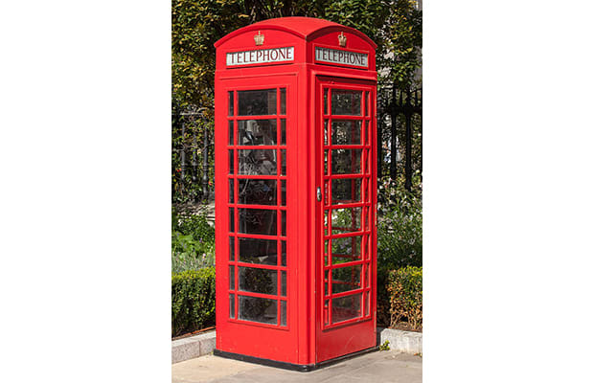

Slide 13
Red Telephone Box Year Invented: 1920 Designer: Sir Giles Gilbert Scott The red telephone boxes found scattered around the UK and occupied territories have become an iconic symbol of England. The first standard telephone kiosk was introduced in 1920. Because of widespread dissatisfaction with the original design, the London metropolitan borough joint standing committee organized a competition to find a more appealing design. Sir Giles Gilbert Scott won the competition, and the post office chose to produce it in steel and paint it red.
YES

Slide 14
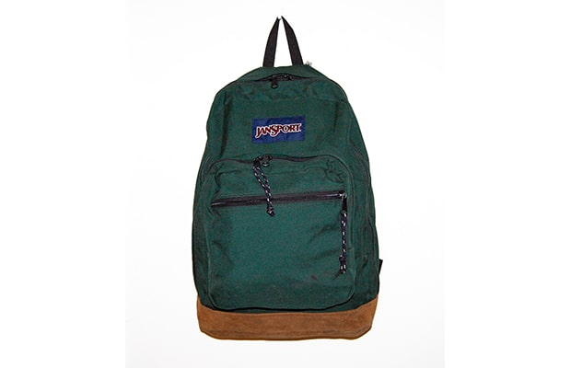

Slide 15
JanSport Backpack Year Invented: 1967 Designer: Murray Pletz, Skip Yowell, and Jan Lewis JanSport came to be through a backpack design competition. An aluminum company sponsored the competition to solicit new backpack designs. Murray Pletz won the competition; with his winnings, he started a new company with his cousin, Skip Yowell, and his girlfriend, Jan Lewis (the namesake of the company). During the '70s, after the company was under new ownership, they started marketing their backpacks more heavily to schools and colleges, and by the 1990s, JanSport was the supplier for almost 30% of backpacks in the U.S.
YES

Slide 16
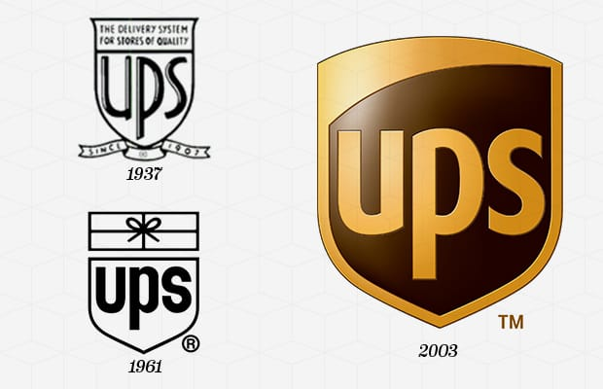

Slide 17
UPS Year Company Founded: 1907 Year Logo Introduced: 1919 Logo Designer: Paul Rand (1961) The first UPS "shield" logo was created in 1916 when founder Jim Casey merged the company with a local rival delivery service, and the shield shape stuck (it is still being used today), with the exception of a few font and design changes. UPS' second logo, introduced in 1937, was the first logo that had the letters "UPS" on it, and in 1961, Paul Rand designed the third UPS logo which featured a bow-tied package above the shield. In 2003, UPS switched to a glossy brown version of logo with the company name contained within the shield.
YES

Slide 18
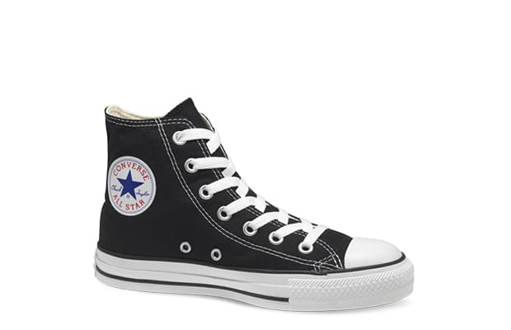

Slide 19
Converse Sneakers Year Invented: 1892 Designer: U.S. Rubber Company The sneaker we are familiar with today stems from the U.S. Rubber Company's design for Keds shoes. These rubber-soled, canvas-topped shoes were mass-produced until 1917. That same year, Marguis Converse produced the first shoe made for basketball, the Converse All Star. In 1923, Chuck Taylor, an Indiana basketball player, endorsed the shoe and the name was changed to Chuck Taylor All-Stars.
YES

Slide 21
Ford Year Company Founded: 1903 Year Logo Introduced: 1903 Logo Designer: Childe Harold Wills (1907) Ford Motor company was actually Henry Ford's third automobile company. The first went bankrupt, and he left the second, which went on to become Cadillac. The original logo for the Ford Motor Co. was an embellished circle with the location and name of the company. It was changed to the famous blue oval in 1927 with the release of the Model A.
YES

Slide 22
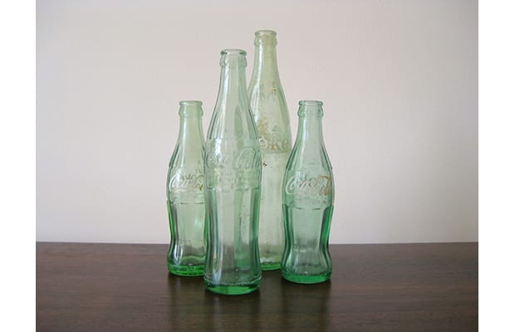

Slide 23
Glass Coca-Cola Bottle Year Invented: 1916 Designer: Root Glass Co. Coca-Cola wanted to create a bottle that could be easily identified by shape alone, so in 1916, Root Glass company designed the 6.5 ounce bottle, inspired by the gourd-shaped coca pod.
YES

Slide 24
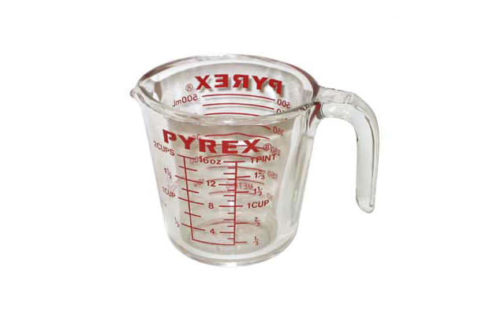

Slide 25
Pyrex Measuring Cup Year Invented: 1915 Designer: Corning Class Works 75% percent of American homes have some kind of Pyrex in their cupboards—either baking dishes, measuring cups, or other items from the line. Pyrex, invented by upstate
YES

