Slide 1
Computer Experience Interactive
How you use your computer/device

Slide 2
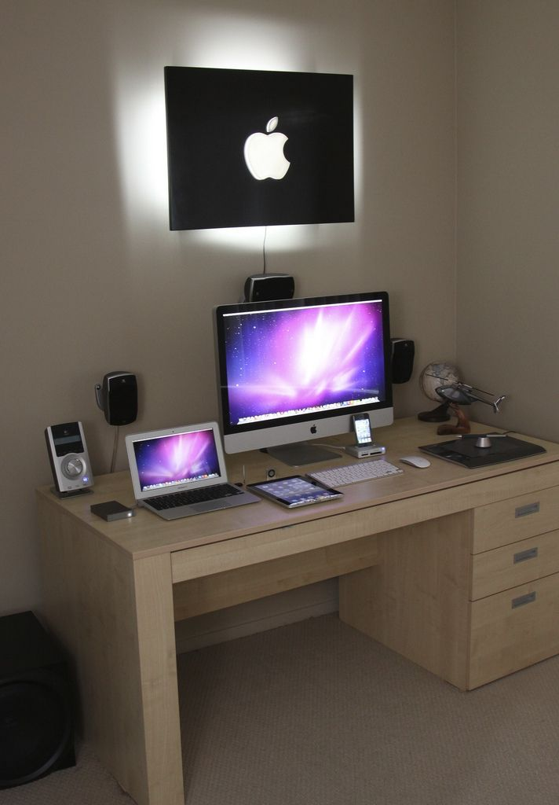
How often do you use the computer at home?
Seldom or never use the computer – go to the back of the room
Use computer 2 to 4 times a month – go to the window side of the room
Use computer weekly – go to the main door side of the room
Use computer daily – go to the front of the room

Slide 3
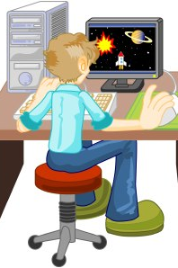
How do you use the computer?
Schoolwork – Raise your right hand
Games / play – Raise your left hand
Create Art/Design– Go to the front of the room
Web Design / Build Websites – Go to the window side of the room
Manipulate Photography- Go to the back of the room

Slide 4

What computer tools/programs have you used?
Google Aps – Raise your right hand
Microsoft Office– Raise your left hand
Illustrator– Go to the front of the room
Photoshop– Go to the window side of the room
InDesign / eDesign- Go to the back of the room
HTML- Go to the main door side of the room

Slide 5

Have you ever used the computer to create art?
Often – Stand up
Sometimes – Raise your right hand
Never – stay seated

Slide 6

Have you ever set up an e-mail account?
Yes = Stand up
No = Stay seated

Slide 7
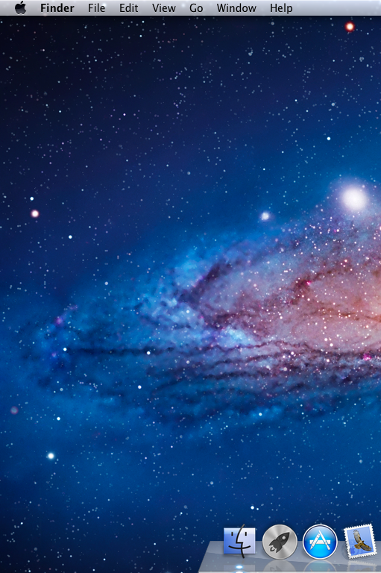
Have you ever worked with Apple OS?
Yes = Stand up
No = Stay seated

Slide 8

Do you know what a font is?
Comic Sans is never the answer
Yes = Stand up
No = Stay seated
Not Sure = Raise your right Hand

Slide 9

How excited are you to be taking ROP Computer Graphic Arts?
Very = Stand up
A Little = Raise your right Hand
Not Sure = Stay seated

Slide 10
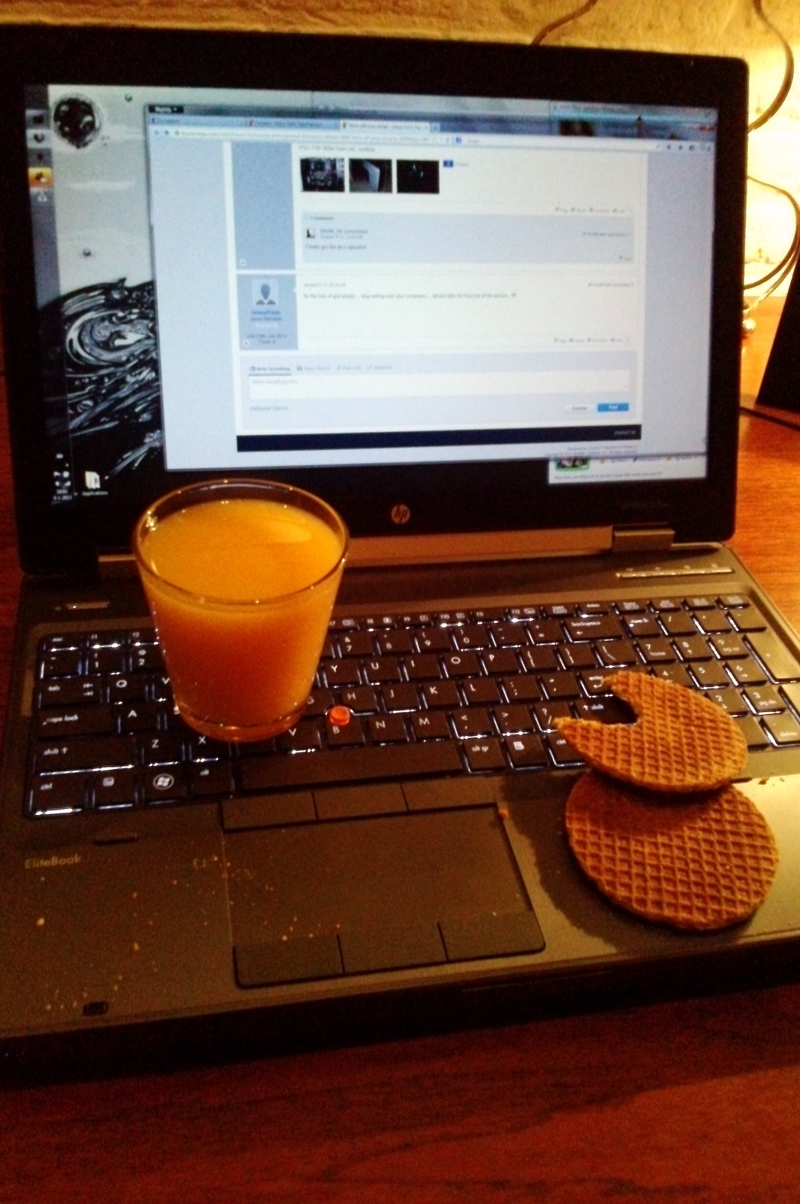
Is it acceptable to have drinks and food in the computer room?
Yes = Go to the front of the room
No = Go to the back of the room
Not Sure = Go to the windows

Slide 11
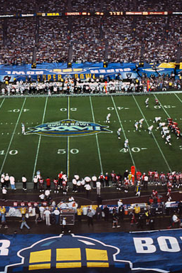
Mrs. Bible mentioned that she designed for professional sports special events. Which events do you think she has attended?
NFL Super Bowl & Pro Bowl= Go to the window side of the room
MLB All-Star Game & World Series = Go to the back of the room
NHL All-Star Game & Winter Classic, NBA All-Star Game = Go to the main door side of the room
All of the above = Go to the front of the room

